Slide 1
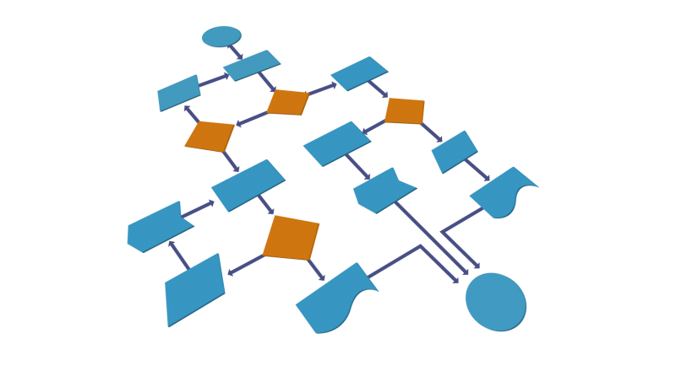


C# Auto Mapping Objects
Manual Mapping
and AutoMapper Library
SoftUni Team
Technical Trainers
Software University
https://about.softuni.bg/

Slide 2
Table of Contents
Data Transfer Objects
Manual Mapping
AutoMapper Library
Mapping ICollection<>
Mapping IQueryable<>
Custom Member Mappings
Mapping Profiles
2

Slide 3
Have a Question?
sli.do
#csharp-db

Slide 4
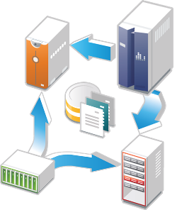
Data Transfer Objects
Definition and Usage

Slide 5
What is a Data Transfer Object?
A DTO is an object that carries data between processes
Used to aggregate only the needed information in a single call
Example: In web applications, between the server and client
Doesn't contain any logic – only stores values
public class ProductDTO
{
public string Name { get; set; }
public int StockQty { get; set; }
}

Slide 6
DTO Usage Scenarios
Hide particular properties that clients are not supposed to view
Remove circular references
Omit some properties in order to reduce payload size
Flatten object graphs that contain nested objects to make them more convenient for clients (denormalization)
Decouple your service layer from your database layer

Slide 7
Manual Mapping (1)
Relationship Diagram
Product
Storage
ProductId
Name
Description
StorageId
Name
Location
ProductStock
Quantity
ProductId
StorageId
Additional data
in mapping table

Slide 8
Manual Mapping (2)
Get product name and stock quantity in a new DTO object
var product = context.Products.FirstOrDefault();
var productDto = new ProductDTO
{
Name = product.Name,
StockQty = product.ProductStocks
.Sum(ps => ps.Quantity)
};
Aggregate information from mapping table

Slide 9

AutoMapper Library
Automatic Translation of Domain Objects

Slide 10
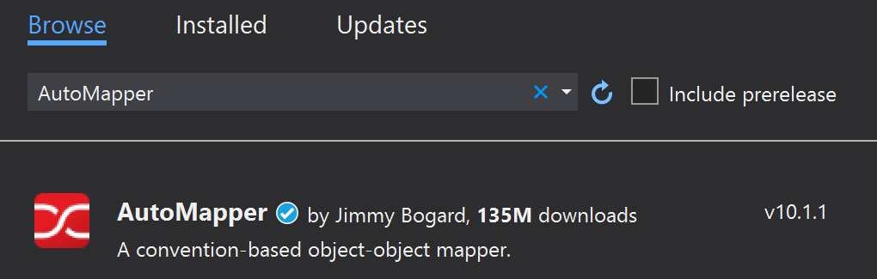
What is AutoMapper?
Library to eliminate manual mapping code
Available as a NuGet Package
Official Website and GitHub
Install-Package AutoMapper
10

Slide 11
Initialization and Configuration
AutoMapper offers an instance service for use and configuration
Add mappings between objects and DTOs
Properties will be mapped by name
var config = new MapperConfiguration(cfg =>
cfg.CreateMap<Product, ProductDTO>());
var mapper = config.CreateMapper();
Source
Target
var product = context.Products.FirstOrDefault();
ProductDTO dto = mapper.Map<ProductDTO>(product);

Slide 12
Multiple Mappings
You can configure all mapping configurations at once
var config = new MapperConfiguration(cfg =>
{
cfg.CreateMap<Product, ProductDTO>();
cfg.CreateMap<Order, OrderDTO>();
cfg.CreateMap<Client, ClientDTO>();
cfg.CreateMap<SupportTicket, TicketDTO>();
});
var mapper = config.CreateMapper();

Slide 13
Mapping ICollection and IQueryable
EF Core uses IQueryable<T> for all DB operations
AutoMapper can work with IQueryable<T> to map classes
Using AutoMapper to map an entire DB collection:
Works like an automatic .Select()
AutoMapper helps EF to generate optimized SELECT SQL query (like projection with an anonymous object)
var posts = context.Posts
.Where(p => p.Author.Username == "Nikolay.IT")
.ProjectTo<PostDto>(config)
.ToList();
IQueryable<Post>
IQueryable<PostDto>

Slide 14
Custom Member Mapping
Map properties that don't match naming convention
var config = new MapperConfiguration(cfg =>
{
cfg.CreateMap<Product, ProductDTO>()
.ForMember(dto => dto.StockQty,
opt => opt.MapFrom(src =>
src.ProductStocks.Sum(p => p.Quantity))));
});
Destination property
Source

Slide 15
Flattening Complex Objects
Flattening of related objects is automatically supported
AutoMapper understands ClientName is the Name of a Client
public class OrderDTO
{
public string ClientName { get; set; }
public decimal Total { get; set; }
}
var config = new MapperConfiguration(cfg =>
cfg.CreateMap<Order, OrderDTO>());
var mapper = config.CreateMapper();
OrderDTO dto = mapper.Map<Order, OrderDTO>(order);

Slide 16
Unflattening Complex Objects
Unflattening of related objects is automatically supported
AutoMapper understands ClientName is the Name of a Client, but to unflatten it, it needs ReverseMap()
public class OrderDTO
{
public string ClientName { get; set; }
public decimal Total { get; set; }
}
var config = new MapperConfiguration(cfg =>
cfg.CreateMap<Order, OrderDTO>().ReverseMap());
var mapper = config.CreateMapper();
Order order = mapper.Map<OrderDTO, Order>(dto);

Slide 17
Mapping Profiles
We can extract our configuration to a class (called a profile)
Using our configuration class:
public class ForumProfile : Profile
{
public ForumProfile()
{
CreateMap<Post, PostDto>();
CreateMap<Category, CategoryDto>();
}
}
using AutoMapper;
var config = new MapperConfiguration(cfg =>
cfg.AddProfile<ForumProfile>());

Slide 18

Summary
…
…
…
To reduce round-trip latency and payload size, data is transformed into a DTO
AutoMapper is a library that automates this process and reduces boilerplate code
Complex objects can be flattened to fractions of their sizes

Slide 19
Questions?
Notes:
19

Slide 20












SoftUni Diamond Partners

Slide 21

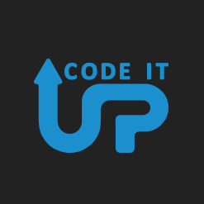
Educational Partners

Slide 22

License
This course (slides, examples, demos, exercises, homework, documents, videos and other assets) is copyrighted content
Unauthorized copy, reproduction or use is illegal
© SoftUni – https://about.softuni.bg
© Software University – https://softuni.bg
Notes:
22

